Slide 1
Class Work for Tuesday, Nov. 24th
For the period today, you have three goals:
Finish and submit your Hanoi lab.
Review Strings and their methods.
Write 3 recursive methods involving Strings.
8-<number>

Slide 2
Goal 1 - Hanoi
Before going on to new lab work today, you first need to make sure your Hanoi lab is complete and fits all requirements in the slides attached to the lab on SchoolLoop.
Fortunately, if you were having a rough time, you now have my flowchart posted on SchoolLoop to help you out. Find the pdf attached to Lab: Hanoi, and use my algorithm if you’re stuck.
7-<number>

Slide 3
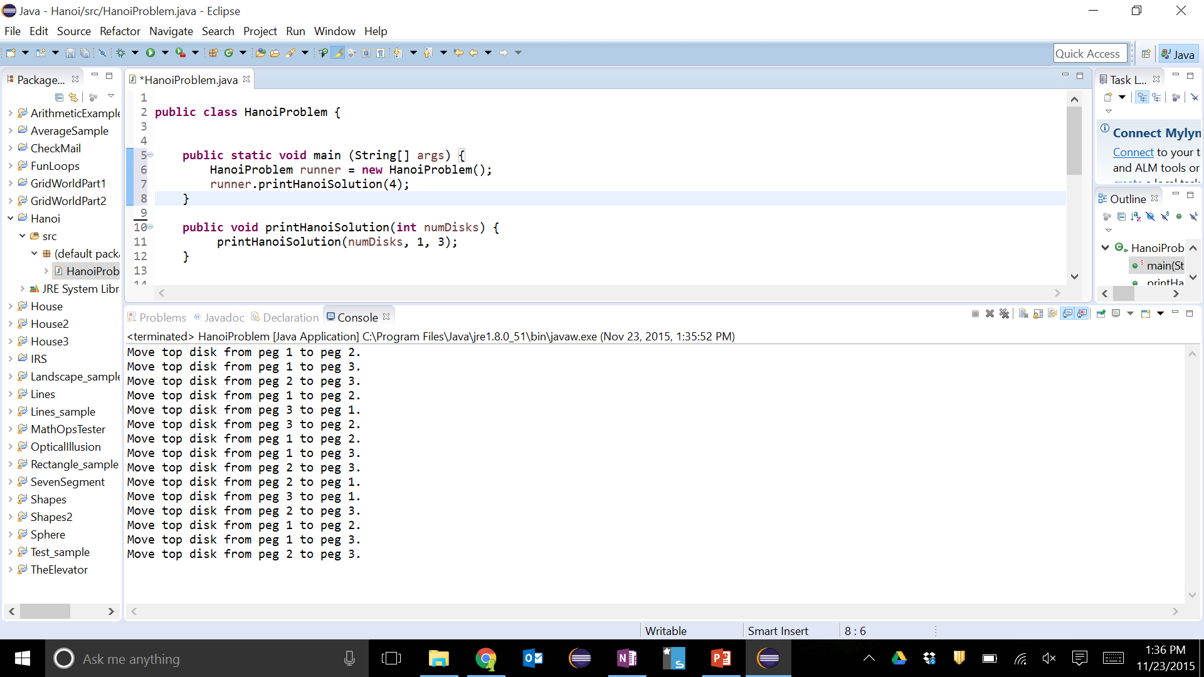
Hanoi
Check your solution by following the steps printed out by your method in the game on-line. Here’s a screenshot showing my output:
I’m also asking you to collect some data on your Hanoi method, similar to the data we collected for Fibonacci. Check the slides on Lab: Hanoi for details.
7-<number>

Slide 4
Goal 2 – Reading
Open up a browser and navigate to:
http://chortle.ccsu.edu/Java5/Notes/chap75/ch75_1.html
Read through this online String & Recursion primer until you hit the ‘exercises’ at the end. Along the way, you should get several examples of using recursion with Strings. Feel free to copy/paste these examples into Eclipse and play with them yourself.
7-<number>

Slide 5
Goal 3 – RecursiveStringTools
Find the attached Word document called “Lab Assignment A10.1 - RecursiveStringUtil 10.doc”. This document describes 3 recursive methods.
Add the attached java file – RecursiveStringTools.java – to a new Eclipse project, then try to complete each of the 3 prompts in the document.
Like Hanoi, these are tricky because you will need to come up with your own algorithm for each.
7-<number>

Slide 6
Submitting
When you get done today, submit to SchoolLoop:
Lab: Hanoi (hopefully completed)
Lab: RecursiveStringTools (where ever you’re at so far)
And submit to the hand-in box:
Hanoi Flowchart
We’ll look at these recursive String methods more after break.
8-<number>

